Slide 1
PRIEE PRESENTATION
TOPIC: LANGUAGE TRANSLATOR WEB APPLICATION
BY
SANJAI S
SHOBAN KUMARESAN
SHRIRAM S
SIVAROOBAN V

Slide 2
PROBLEM STATEMENT
A large portion of the resource materials and other texts are only available in English.
Experts at their level translate it which consumes a large amount of time that could have been utilized in developing novel methodologies.
The Challenge is to develop a system that can translate text from English to other Indian
regional languages with minimum human input for proofreading and with very high accuracy.

Slide 3
ABSTRACT
In our increasingly interconnected world, communication barriers due to language differences persist as a significant challenge.
To address this, we propose a cutting-edge language translator application designed to break down linguistic barriers and facilitate seamless communication across diverse linguistic landscapes.
Our multilingual translator leverages state-of-the-art machine learning algorithms and natural language processing techniques to accurately translate text and speech between multiple languages in real-time.
Powered by deep neural networks, our system continually learns and improves its translation accuracy, ensuring high-quality across various language pairs.

Slide 4
OBJECTIVES
The multilingual translator application aims to revolutionize communication by addressing the challenges posed by linguistic diversity.
Its objectives encompass various aspects of facilitating seamless and inclusive interactions across languages.
Firstly, the application seeks to bridge language gaps by providing accurate translations between multiple languages, fostering cross-cultural understanding, and promoting inclusivity in diverse settings.
Additionally, it aims to enhance accessibility for individuals with limited proficiency in certain languages, enabling them to participate more effectively in conversations and access information in their preferred Language.

Slide 5
PROPOSED SYSTEM
Advanced Neural Network Architecture: Utilize state-of-the-art neural network architectures such as transformer models, with enhancements tailored specifically for language translation tasks. These models can effectively capture long-range dependencies and contextual information, leading to more accurate translations.
Multi-modal Translation: Incorporate multi-modal input, such as text, speech, and images, to provide more comprehensive and accurate translations. For example, users could input text, speak into a microphone, or even take a picture of written text for translation.
Dynamic Context Adaptation: Develop algorithms that dynamically adapt to the context of the conversation or text being translated. This includes recognizing and preserving the context of previous messages in a conversation thread, enabling more coherent and contextually relevant translations.

Slide 6
EXISTING SYSTEM
While they've improved significantly, translation systems often struggle with accurately capturing the nuances, idioms, and cultural contexts of languages, leading to inaccuracies and unnatural-sounding translations.
Many translation systems perform well with widely spoken languages but may struggle with less common or under-resourced languages due to the lack of data for training and refining the algorithms.
Translation systems sometimes fail to grasp the broader context of a sentence or conversation, leading to mistranslations, especially in ambiguous or complex texts.
Translators may inadvertently produce translations that are culturally insensitive or inappropriate due to differences in cultural norms, expressions, or sensitivities.

Slide 7
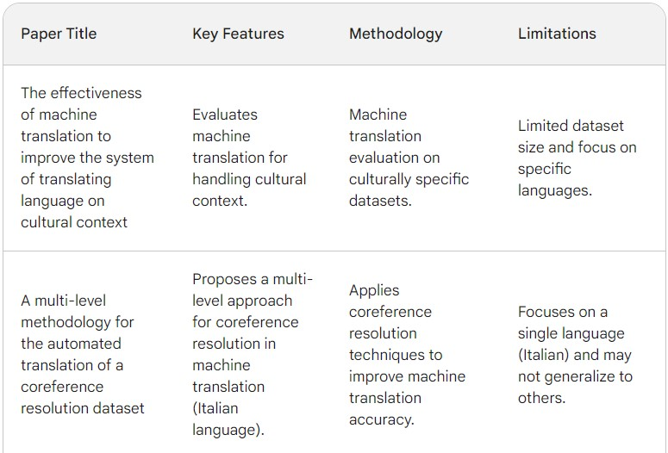
LITERATURE SURVEY

Slide 8
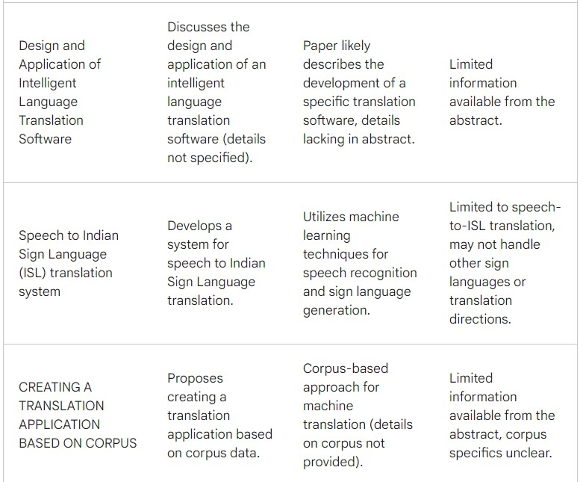
LITERATURE SURVEY

Slide 9
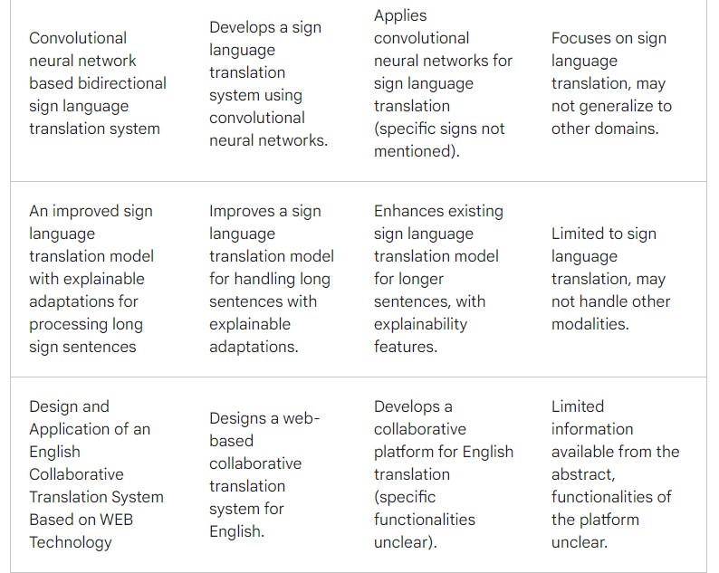
LITERATURE SURVEY

Slide 10
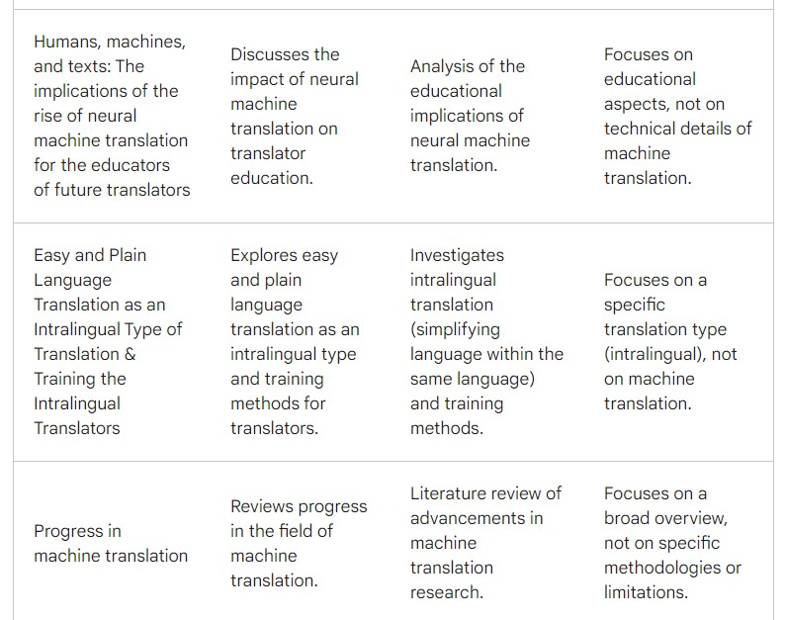
LITERATURE SURVEY

Slide 11
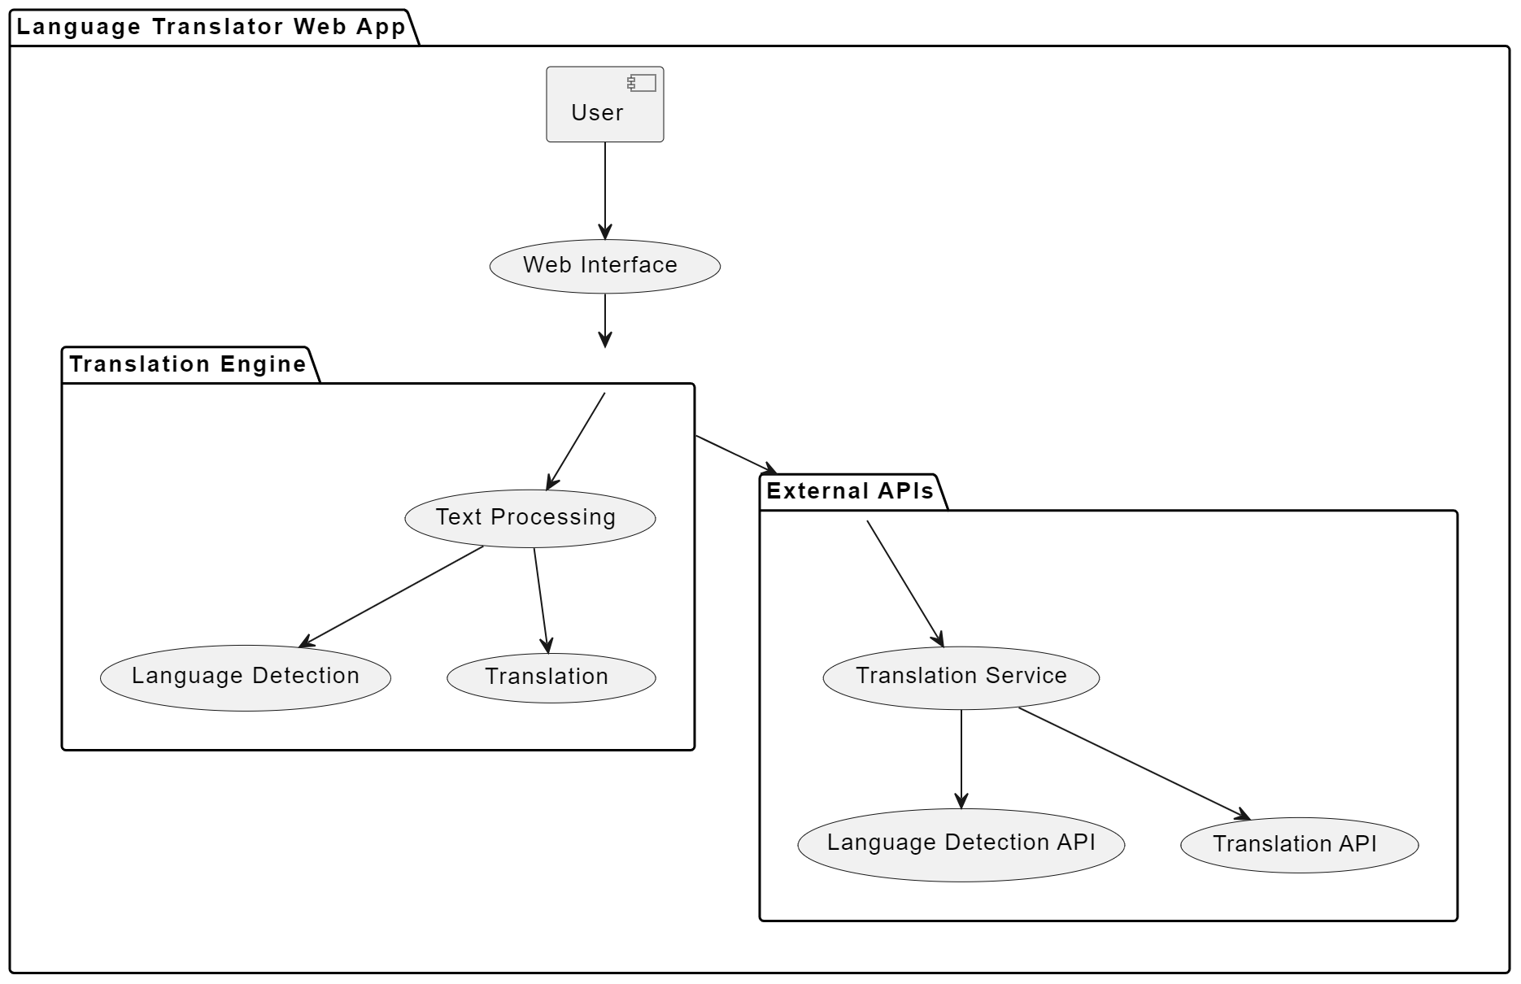
MODEL ARCHITECTURE

Slide 12
IMPLEMENTATION ANALYSIS
Implemented in HTML5, CSS, JAVASCRIPT
System specifications for web applications include an Intel core-i5-7700 CPU running time at 3.60 Ghz, 16GB of RAM, and an Nvidia Titan GPU.

Slide 13
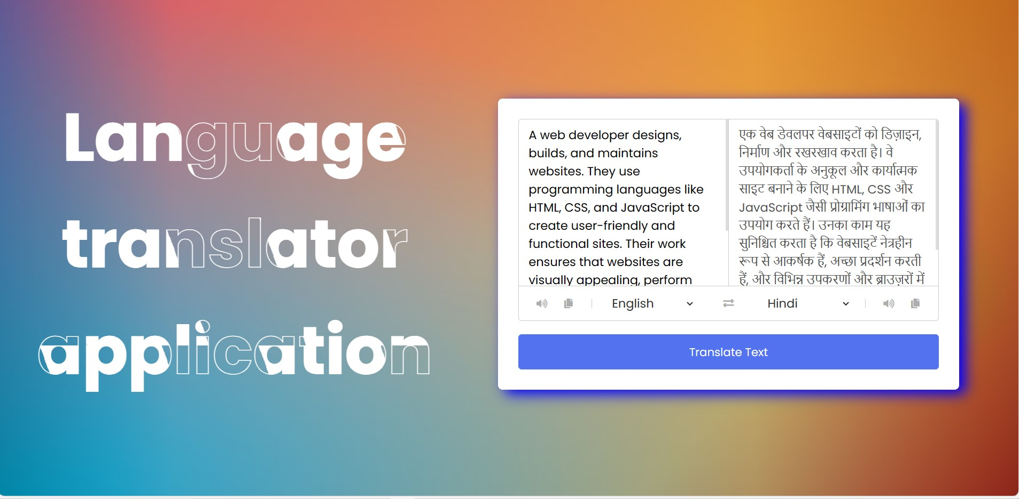
RESULTS AND DISCUSSIONS
This screenshot depicts an interface of a language translator application. On the left, it shows the English text describing a web developer's role.
On the right, the translated text appears in Hindi. Users can select languages from dropdown menus below the text boxes.

Slide 14
CONCLUSION AND FUTURE WORK
In summary, the creation and application of web-based language translators mark a substantial technological achievement with wide-ranging effects on accessibility and international communication.
Language barriers and cross-linguistic information access have never been simpler because of these system’s combination of advanced neural network models, creative preprocessing and postprocessing methods, and intuitive user interfaces.
FUTURE ENHANCEMENTS:
Adding more language options to support a wider user base.
Implementing speech-to-text and text-to-speech features for hands-free use.
Incorporating machine learning for more accurate translations and context understanding.
Allowing users to save and manage their translation history for easy access.
Integrating an offline mode for translation without an internet connection.

Slide 15
REFERENCES
1. The effectiveness of machine translation to improve the system of translating language on cultural context
MRA Latief, NJ Saleh, A Pammu - IOP Conference Series: Earth …, 2020 - iopscience.iop.org
2. A multi-level methodology for the automated translation of a coreference resolution dataset: an application to the Italian language
A Minutolo, R Guarasci, E Damiano, G De Pietro… - Neural Computing and …, 2022 – Springer
3. Design and Application of Intelligent Language Translation Software
R Tang, S Wu, X Sun - 2023 2nd International Conference on …, 2023 - ieeexplore.ieee.org
4. Speech to Indian sign language (ISL) translation system
P Sonawane, K Shah, P Patel, S Shah… - … and intelligent systems …, 2021 - ieeexplore.ieee.org
5. CREATING A TRANSLATION APPLICATION BASED ON CORPUS.
M Sapaev - SCIENTIFIC ASPECTS AND TRENDS IN THE FIELD …, 2023 - interonconf.org

Slide 16
REFERENCES
6. Convolutional neural network-based bidirectional sign language translation system
L Fernandes, P Dalvi, A Junnarkar… - … Conference on Smart …, 2020 - ieeexplore.ieee.org
7. An improved sign language translation model with explainable adaptations for processing long sign sentences
J Zheng, Z Zhao, M Chen, J Chen… - Computational …, 2020 - downloads.hindawi.com
8. Design and Application of an English Collaborative Translation System Based on WEB Technology
A Li - 2023 International Conference on Data Science and …, 2023 - ieeexplore.ieee.org
9. Humans, machines, and texts: The implications of the rise of neural machine translation for the educators of future translators
T Kovács - Fit-for-market translator and interpreter training in a …, 2020 - books.google.com
10. Easy and Plain Language Translation as an Intralingual Type of Translation & Training the Intralingual Translators
NV Nechaeva, KS Helmle… - Science Journal of …, 2021 - scholar.archive.org

Slide 17
THANK YOU

